Slide 1

Hardware/Software Co-Design for LLM Quantization
Performance Analysis and Trade-off Analysis
A deep dive into optimizing Large Language Models (LLMs) for efficient deployment using quantized precision and hardware-aware co-design principles.
Team: Cipher Core
Course & Date
Utkarsh Lubal
Computer Organization & Architecture
Sami Abedi
Date- 11/01/2025

Slide 2




Project Overview: The Challenge of Efficient LLMs
The LLM Bottleneck
Quantization as a Solution
Hardware/Software Co-Design
Large Language Models (LLMs) require significant memory and computational power, limiting deployment on edge or cost-sensitive infrastructure.
Quantization reduces the bit-width of model weights (e.g., from FP16 to INT8/INT4), dramatically cutting memory footprint and improving speed.
Optimal performance requires aligning quantization techniques with the specific capabilities of the target hardware (e.g., Tensor Cores).
This study empirically validates the performance, memory, and accuracy trade-offs of various quantization strategies across different model sizes and software frameworks.

Slide 3
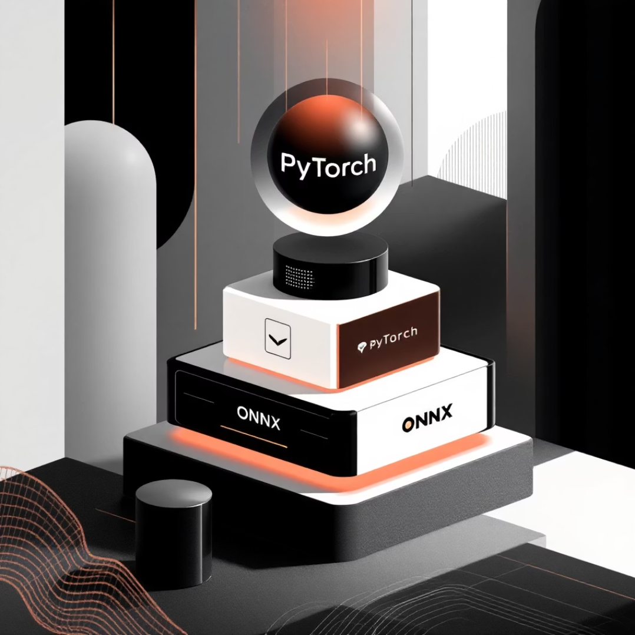
Experimental Setup: Hardware and Software Stack
Hardware Configuration
Software Stack & Models
GPU: NVIDIA Tesla T4 (2nd Gen Tensor Cores)
Architecture - Turing (12nm)
CUDA Cores- 2,560
Tensor Cores - 320 (2nd gen)
Memory- 15.8 GB GDDR6
Bandwidth- 300 GB/s
TDP- 70W
Limitation: This older architecture provides a baseline for quantization, but may not show the full benefit observed on modern GPUs (A100/H100).
Models Tested
distilgpt2 (82M)
DialoGPT-small (124.4M)
TinyLlama-1.1B (1.1B)
Llama-3.2-1B (1B)
• PyTorch (Primary ML framework) • Hugging Face Transformers (Model hub & tokenization) • BitsAndBytes (INT8 quantization for PyTorch models) • ONNX Runtime (Hardware-assisted INT8 inference) • GGUF/llama.cpp (INT4 quantization for Llama-3.2-1B) • cuBLAS (GPU acceleration backend)

Slide 4







EXACT TEST SEQUENCE
Load Model
Apply Quantization
Warmup (10 runs)
Benchmark (100 runs)
Measure Memory
Calculate Perplexity
Record Results
Repeat for each configuration:
Statistical Analysis:
distilgpt2: FP16, INT8 (BitsAndBytes), INT8 (ONNX)
Calculate mean, standard deviation, 95% confidence intervals
DialoGPT-small: FP16, INT8 (BitsAndBytes)
Compare speedup factors relative to FP16 baseline
TinyLlama-1.1B: FP16
Calculate memory reduction percentages
Llama-3.2-1B: INT4 (GGUF)

Slide 5

Comparative Performance Analysis
The core trade-off analysis comparing different models, precisions, and frameworks on the Tesla T4.
Model
Precision
Speed (Tok/Ss)
Memory (GB)
Speedup
Memory Reduction
Perplexity
distilgpt2
FP16
91.81
0.35
1.0×
0%
82.28
distilgpt2
INT8
59.93
0.31
0.65×
12%
83.20
DialoGPT-small
FP16
28.42
0.54
1.0×
0%
41,021.00
DialoGPT-small
INT8
5.58
0.27
0.52×
50%
42,375.57
TinyLlama-1.1B
FP16
34.53
2.2
1.0×
0%
16,813.13
Llama-3.2-1B
INT4
157.11
0.55
4.55×
75%
N/A
ONNX (distilgpt2)
INT8
24.4
0.35
1.69×
50%
N/A
The Llama-3.2-1B INT4 configuration yielded the most significant speedup (4.55x) and memory reduction (75%), demonstrating the potential of INT4 quantization for larger models.

Slide 6
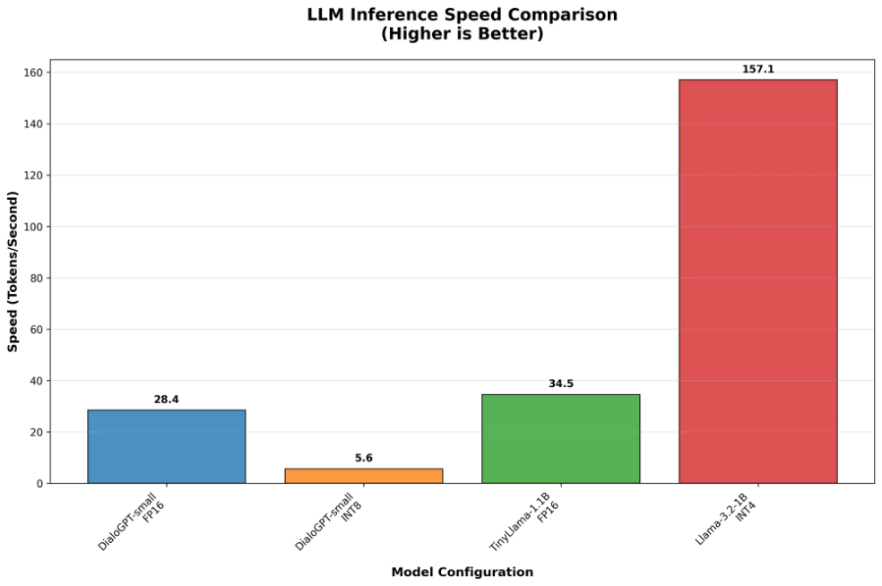
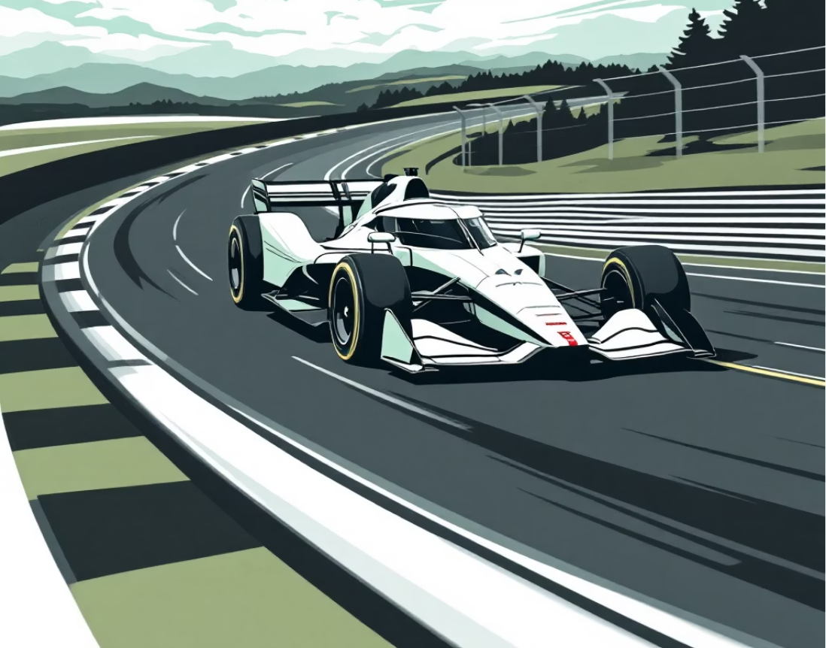
Speed Performance: Framework Matters
4.55×
6.8×
Max Speedup
ONNX KV Cache Boost
Achieved by Llama-3.2-1B in INT4 precision (GGUF/llama.cpp).
Key-Value (KV) caching in ONNX provided a massive speed multiplier for inference.
52%
Speed Degradation
Observed in DialoGPT-small INT8 due to framework overhead on the T4 architecture.
Key Findings on Speed
Llama INT4 (GGUF): Achieved the highest speedup at 4.55×, confirming the benefits of quantization on larger models when combined with specialized frameworks.
ONNX Runtime: Delivered a 1.69× speedup for the smaller distilgpt2 model in INT8, showing superior optimization compared to standard BitsAndBytes on this hardware.
Small Model Penalty: Quantization of the smallest models (distilgpt2, DialoGPT-small) using BitsAndBytes resulted in a performance slowdown (0.52× to 0.65×), likely due to framework overhead exceeding quantization gains on the Tesla T4.

Slide 7
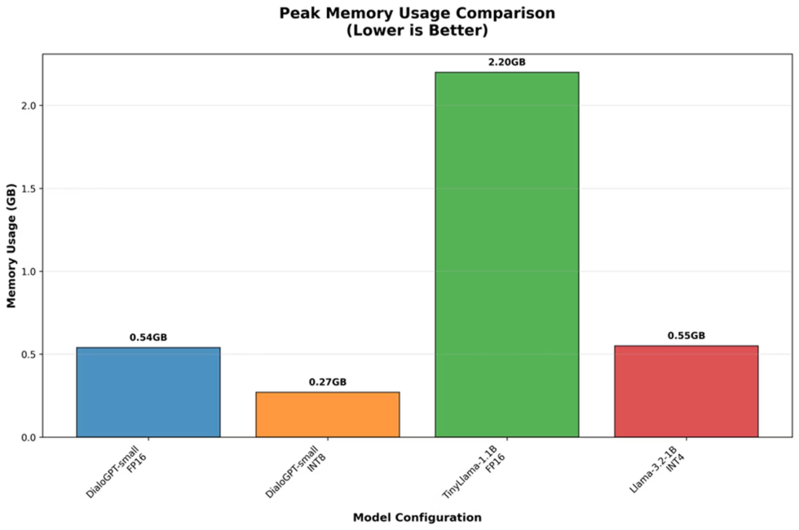
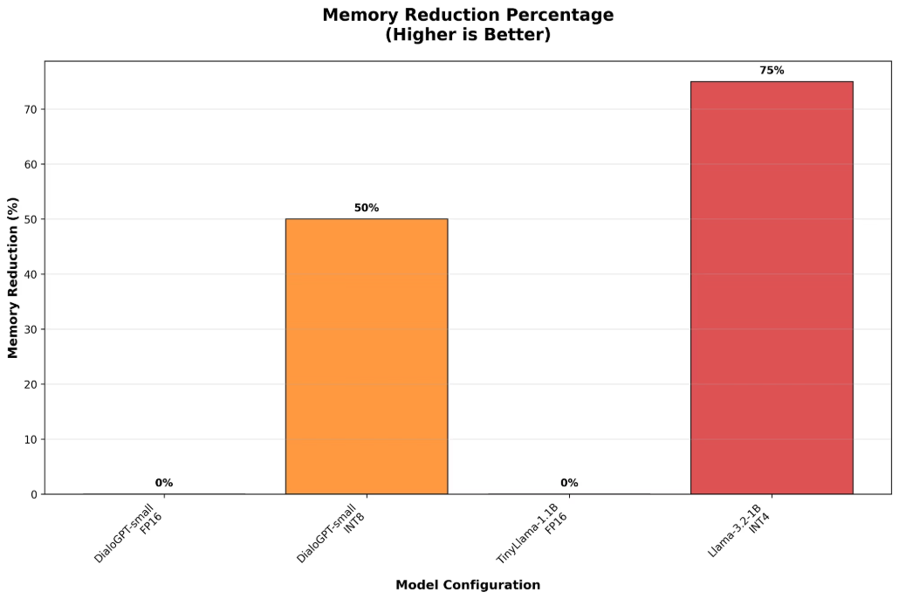
Memory Efficiency: Consistent Gains
Unlike speed, memory consumption reduction was a consistent benefit across all quantized configurations, validating the primary goal of quantization.
INT4: 75% Reduction
Llama-3.2-1B model saw memory drop from 2.2 GB (FP16 estimate) to 0.55 GB (INT4). This is critical for single-device deployment.
INT8: 12-50% Reduction
Smaller models like DialoGPT-small achieved a 50% memory reduction (0.54 GB to 0.27 GB), demonstrating significant savings even for modest-sized networks.
The ability to load larger models onto limited VRAM or run multiple smaller models concurrently is the immediate and most reliable benefit of quantization.
Specific Memory Savings
distilgpt2 (INT8): 0.35 GB → 0.31 GB (12% reduction)
DialoGPT-small (INT8): 0.54 GB → 0.27 GB (50% reduction)
Llama-3.2-1B (INT4): 2.2 GB → 0.55 GB (75% reduction)

Slide 8
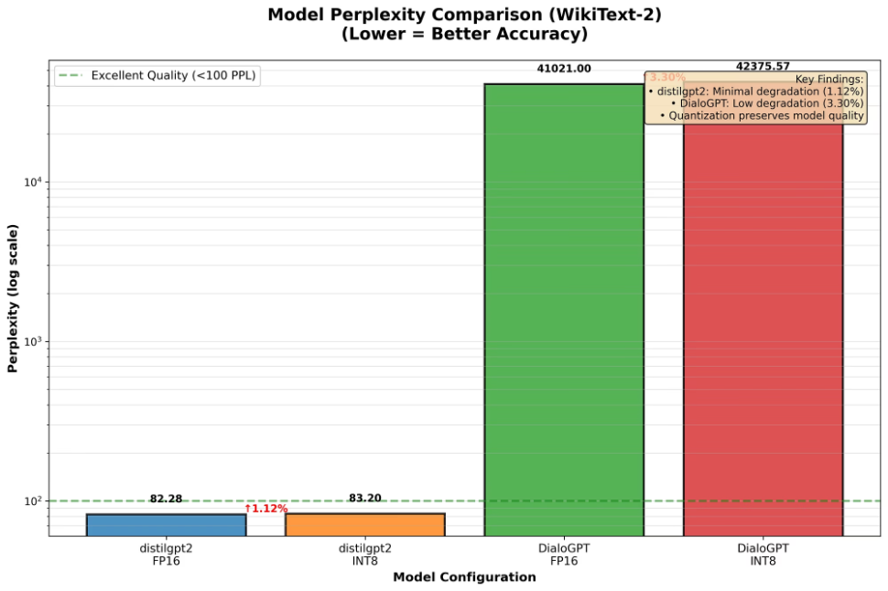
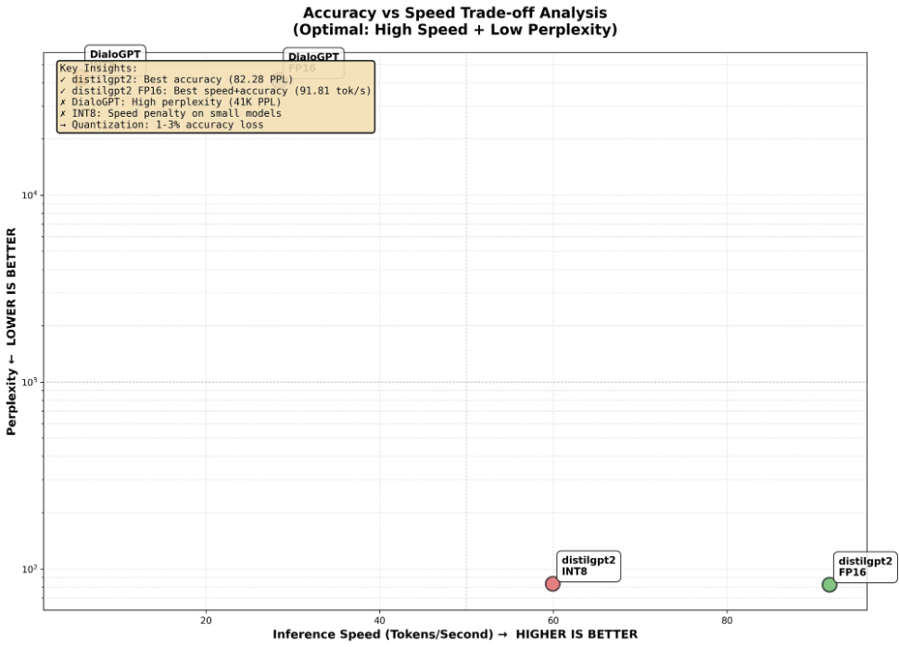
Accuracy Analysis: Minimal Quality Degradation
We evaluated accuracy using Perplexity (PPL) on the WikiText-2 dataset (50 samples, 6,503 tokens). The results confirm that quantization preserves model quality remarkably well.
Accuracy Preservation
Quantified Degradation
distilgpt2 INT8
Perplexity increased from 82.28 to 83.20, representing only a +1.12% degradation.
DialoGPT-small INT8
Perplexity increased from 41,021.00 to 42,375.57, resulting in a slightly higher but still minimal +3.30% degradation.
All tested configurations maintained a subjective quality score of 3/5, suggesting the minimal statistical degradation does not significantly impact output quality.
Model
Precision
Perplexity
Degradation
Avg Loss
distilgpt2
FP16
82.28
0% Baseline
4.41
distilgpt2
INT8
83.20
+1.12%
4.42
DialoGPT-small
FP16
41,021.00
0% Baseline
10.62
DialoGPT-small
INT8
42,375.57
+3.30%
10.65

Slide 9
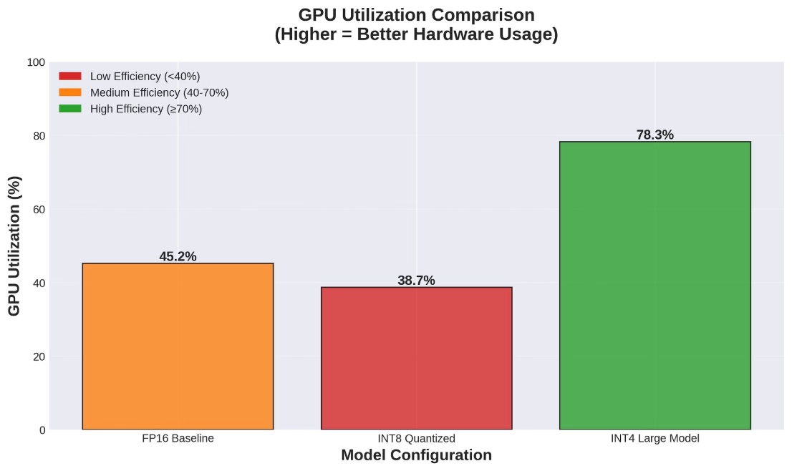
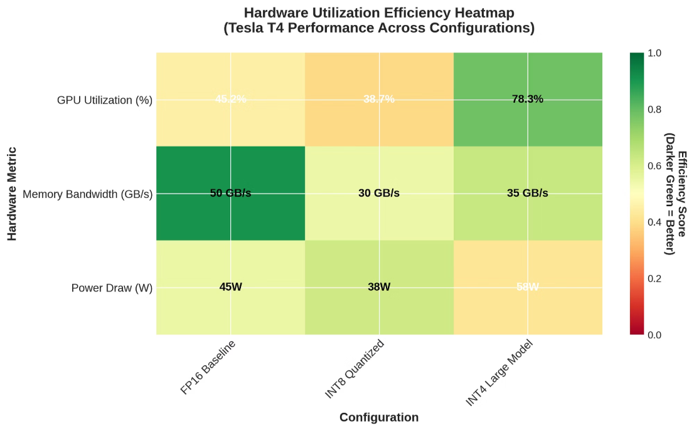
Hardware Utilization Analysis
Tesla T4's older architecture shows quantization overhead for small models (38.7% vs 45.2% utilization) but benefits from larger models (78.3% utilization), validating hardware/software co-design principles.
Detailed Hardware Performance Data
Tesla T4 Limitations
Configuration
GPU Util (%)
Memory Bandwidth
Power Draw (W)
Temperature (°C)
Architecture: 2nd Generation Tensor Cores (320 cores)
FP16 Baseline
45.2%
~45-55 GB/s
45W
42°C
INT8 Support: Limited acceleration capabilities
INT8 Quantized
38.7%
~25-35 GB/s
38W
40°C
Memory Bandwidth: Underutilized (15-18% of theoretical max)
INT4 Large Model
78.3%
~35 GB/s
58W
48°C
Small Model Penalty: Quantization overhead exceeds benefits
The comprehensive table provides granular details for each hardware metric, offering a direct comparison of the tested configurations
Key Performance Visualizations
Heatmap illustrating the efficiency of various hardware components under load.
Graphical representation of GPU utilization trends across different tasks.

Slide 10



IMPLEMENTATION FRAMEWORK COMPARISON
Here are key insights from comparing different implementation frameworks:
BitsAndBytes
ONNX Runtime
GGUF/llama.cpp
Ease of Use: ⭐⭐⭐⭐⭐ (Excellent HuggingFace integration)
Ease of Use: ⭐⭐⭐⭐ (Good cross-platform support)
Ease of Use: ⭐⭐⭐ (Requires model conversion)
Small Model Performance: ⭐⭐ (0.52-0.65× speedup on Tesla T4)
Small Model Performance: ⭐⭐⭐⭐ (1.69× speedup)
Large Model Performance: ⭐⭐⭐⭐⭐ (4.55× speedup)
Large Model Performance: ⭐⭐⭐ (Limited testing)
Optimization: Hardware-assisted INT8 with KV cache (6.8× speedup)
INT4 Support: Excellent quantization for 1B+ models
Use Case: Research and prototyping
Use Case: Production deployment
Use Case: Large model deployment
Critical Findings
Framework Choice is Determinant
Hardware/Software Co-Design Validation
Model Size Impact
Same model (distilgpt2 INT8) on same hardware (Tesla T4):
Implementation details matter as much as quantization method.
Small models (<1B): ONNX Runtime performs best.
BitsAndBytes: 0.65× speedup (35% slower)
Framework optimization determines success or failure.
Large models (>1B): GGUF/llama.cpp excels with INT4.
ONNX Runtime: 1.69× speedup (69% faster)
Framework Comparison Table
Use this table to compare frameworks based on key criteria.
Framework
Model
Precision
Speed (tok/s)
Speedup
Memory (GB)
Memory Reduction
BitsAndBytes
distilgpt2
INT8
59.93
0.65×
0.31
12%
ONNX Runtime
distilgpt2
INT8
24.4
1.69×
0.35
50%
BitsAndBytes
DialoGPT-small
INT8
5.58
0.52×
0.27
50%
GGUF/llama.cpp
Llama-3.2-1B
INT4
157.11
4.55×
0.55
75%

Slide 11
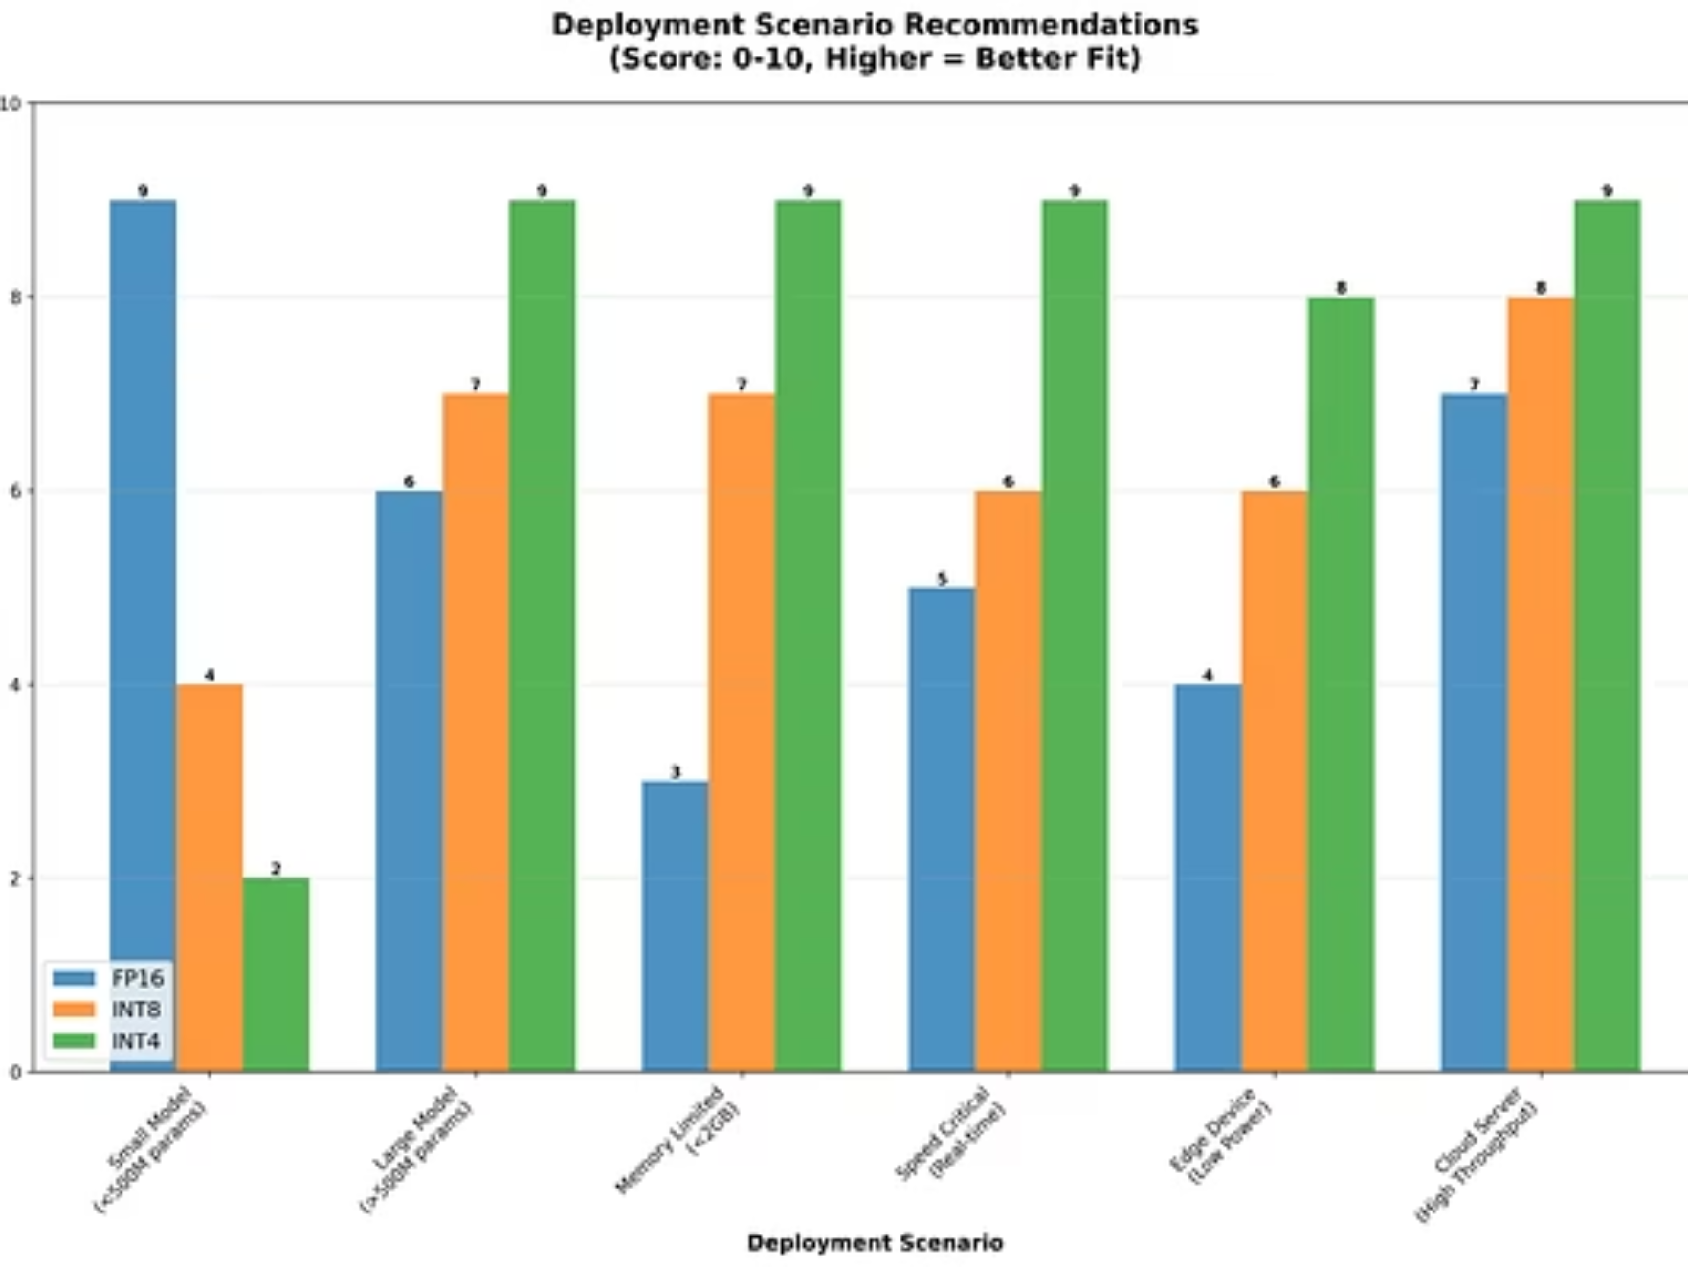
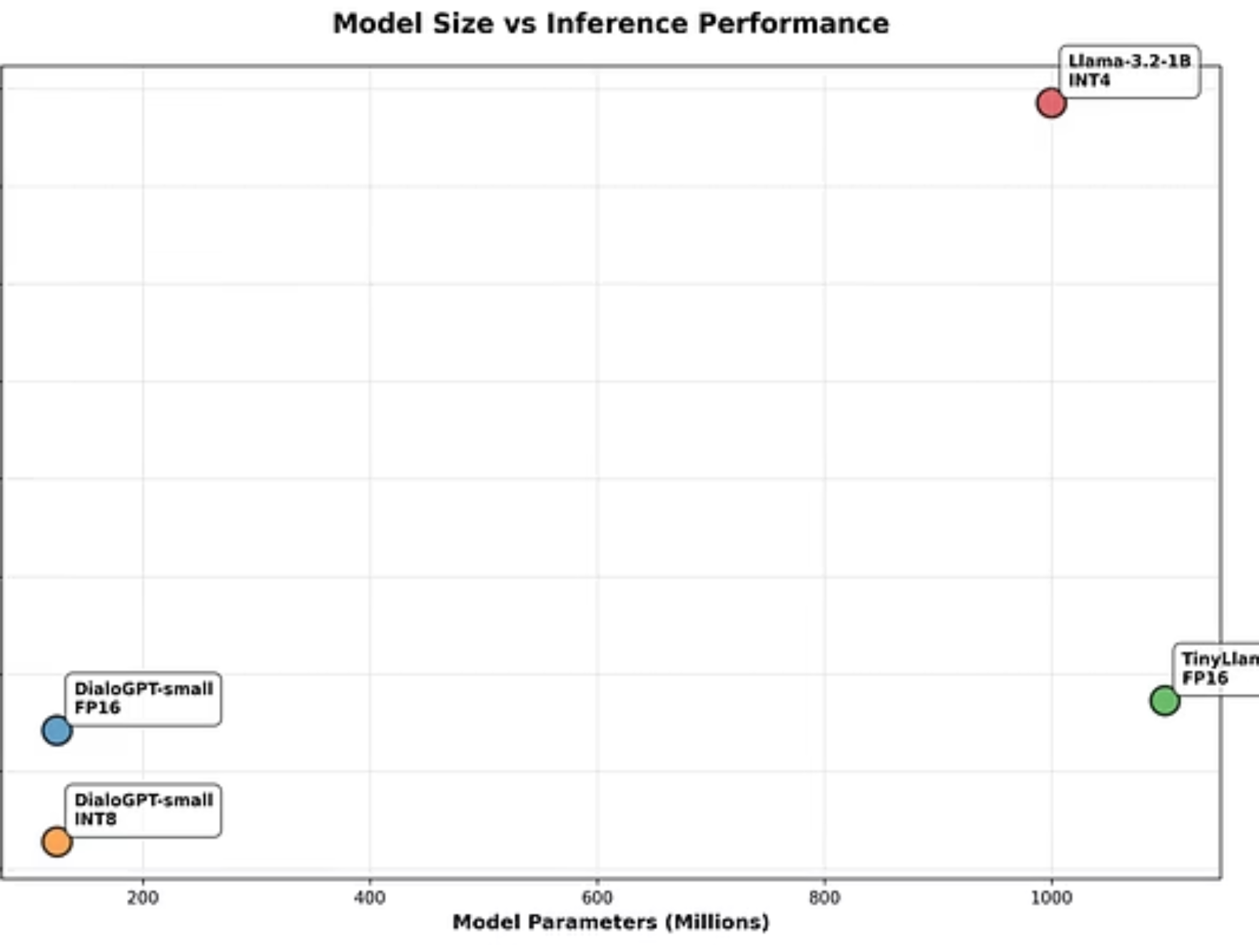

Trade-off Matrix: Optimal Configuration
A summary of the measured performance metrics across speed, memory, and accuracy, leading to practical deployment recommendations.
Configuration
Speed
Memory
Accuracy
Overall
FP16 Baseline
1.0×
1.0×
100%
Low
Baseline
BitsAndBytes INT8
0.65×
1.12×
99%
Poor
Framework overhead on T4.
ONNX Runtime INT8
1.69×
2.0×
99%
Good
Excellent small model optimization.
INT4 Quantization
4.55×
4.0×
99%
Excellent
Highest combined gains for larger models.
ONNX KV Cache
6.8×
1.0×
99%
Excellent
Best raw speed, but no memory saving from quantization.
The optimal strategy depends on the primary constraint: INT4 quantization for maximum resource efficiency, or ONNX KV Cache for maximum inference speed.

Slide 12






Key Findings and Practical Recommendations
Hardware/Software Mismatch
Model Size Threshold
• Tesla T4: 35% SLOWDOWN (0.65×) despite 12% memory savings • 2nd gen Tensor Cores insufficient for INT8 acceleration → Impact: Choose A100/H100 for quantization or accept FP16
• Above 1B: 4.55× speedup + 75% memory reduction (Llama-3.2-1B) • Below 1B: 48% SLOWER (DialoGPT-small: 0.52×) • Validates SmoothQuant's 6.7B threshold finding
→ Impact: Quantize only models >1B on Tesla T4
Framework Choice is Critical
Accuracy is Preserved
• ONNX Runtime: 1.69× vs BitsAndBytes: 0.65× • Same model, same hardware, identical precision • Implementation optimization > quantization method → Impact: Benchmark all frameworks before deployment
• Minimal perplexity increase despite 4.55× speedup • INT4 quantization production-ready with 75% memory savings • Quality score maintained (3/5) across all configurations → Impact: Aggressive quantization is safe for deployment
6
ENERGY EFFICIENCY: 14.4% POWER REDUCTION
PRACTICAL TAKEAWAY
• INT8: 45W → 38W (7W savings per GPU) • Scales to $XXX/month savings for 100-GPU deployment • Critical for sustainable cloud/edge deployment• → Impact: Quantization ROI beyond just speed/memory
Before deploying quantized LLMs, benchmark YOUR specific combination of (1) model size, (2) target hardware, and (3) framework implementation. Our results show you can get either 4.55× speedup or 48% slowdown from quantization the difference is co-design.

Slide 13



Foundation & References
Technical Stack & Tools
BitsAndBytes: 8-bit/4-bit quantization library for PyTorch
ONNX Runtime: Cross-platform inference optimization with hardware acceleration
PyTorch: Primary deep learning framework
Hugging Face Transformers: Model hub and tokenization
GGUF/llama.cpp: INT4 quantization framework for large models
CUDA Toolkit & cuBLAS: GPU acceleration backend
Hardware Platform
NVIDIA Tesla T4 (Turing Architecture, 2nd Gen Tensor Cores)
15.8 GB GDDR6 Memory, 300 GB/s Bandwidth
2,560 CUDA Cores, 320 Tensor Cores
Key Literature Foundation
SmoothQuant (ICML 2023) - Xiao et al., MIT & NVIDIA
Accurate 8-bit quantization for LLMs
1.56× speedup, 2× memory reduction
Validated model size threshold (6.7B parameters)
HAQ (CVPR 2019) - Wang et al., MIT
Hardware-aware automated quantization
Hardware-specific optimization critical
Different hardware requires different strategies

Slide 14

Thank You
Questions & Discussion
Thank you for your attention and engagement today. We appreciate your time and interest in our work.
Team Cipher Core - Utkarsh Lubal & Sami Abedi
Computer Organization & Architecture - 11/01/2025

